Slide 1
RESTRUCTURING TECHNIQUES

Slide 2


Slide 3
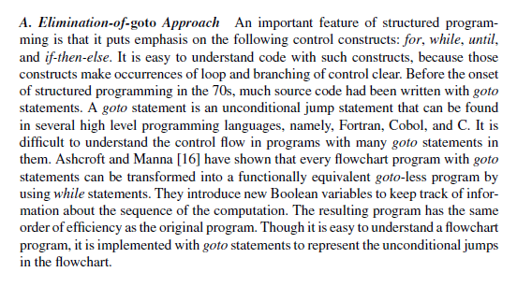

Slide 4
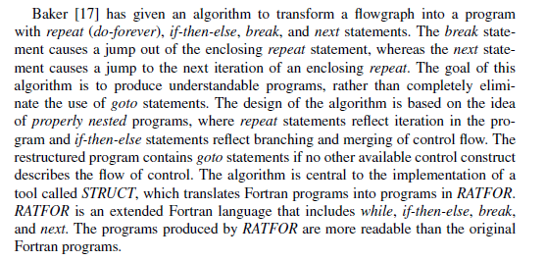

Slide 5
